Slide 1

Department of Computer Engineering
Sequential Logic Design – Applications
1

Slide 2
Points covered
Department of Computer Engineering
Applications
2

Slide 3
Department Vision & Mission
Department of Computer Engineering
Vision
Achieve academic excellence through education in computing, to create intellectual manpower to explore professional, higher educational and social opportunities.
Mission
To impart learning by educating students with conceptual knowledge and hands on practices using modern tools, FOSS technologies and competency skills there by igniting the young minds for innovative thinking, professional expertise and research.

Slide 4
Bounce Elimination Switch
Mechanical switches are employed digital systems as input devices by which digital information is entered into the system.
In Sequential circuit , if 1 is to be entered through a switch , then the switch is thrown to the corresponding position. The output oscillates between 0 and 1 creates difficulty in the operation of system. This problem is eliminated by Bounce Elimination Switch.

Slide 5
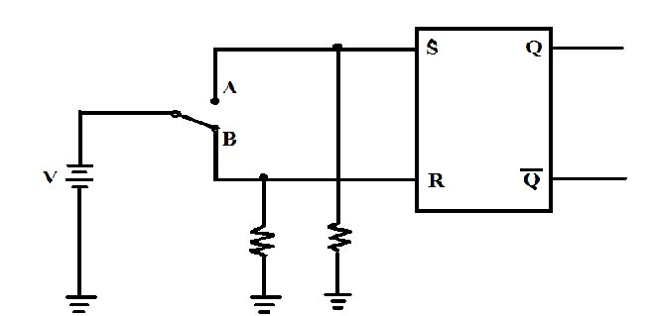
Switch Denouncer

Slide 6
Registers
A register s composed of group of Flip Flops to store group of bits.
For storing N bit word , N number of Flip Flops are required.
One Flip Flop is required for storing each bit.
There are different way to enter data in registers.

Slide 7
Counters
Digital counters are often needed to count events.
The counter are also composed of Flip Flops.
A circuit with n Flip Fops has 2^{n} possible states

Slide 8
Department of Computer Engineering
Thank you

